Slide 1
LEADERSHIP
BY: AQSA FAYYAZ
Fast-nuces , Karachi

Slide 2
LEARNING outcomes
Recipe for being a Leader
Understanding Leadership styles

Slide 3
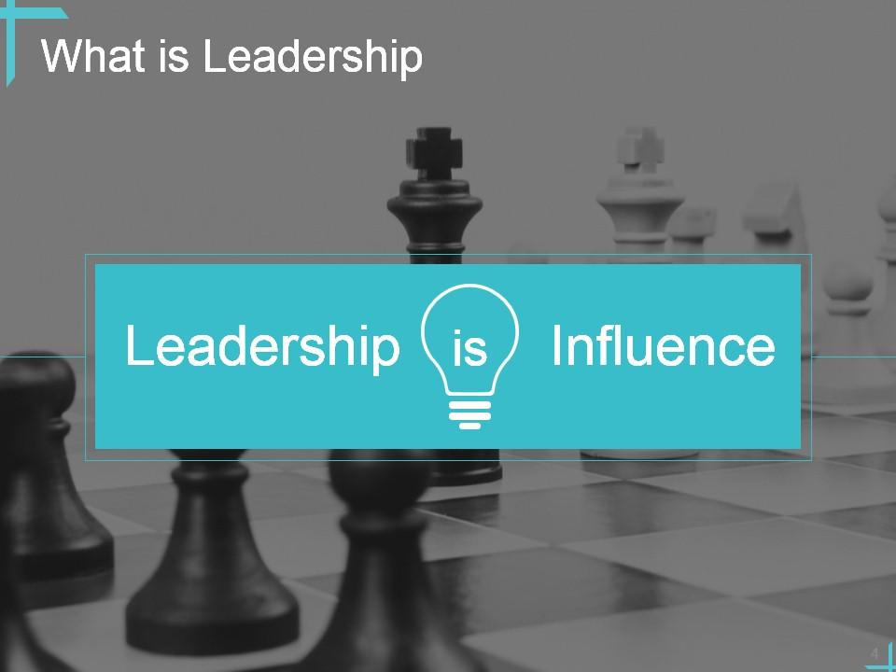

Slide 4
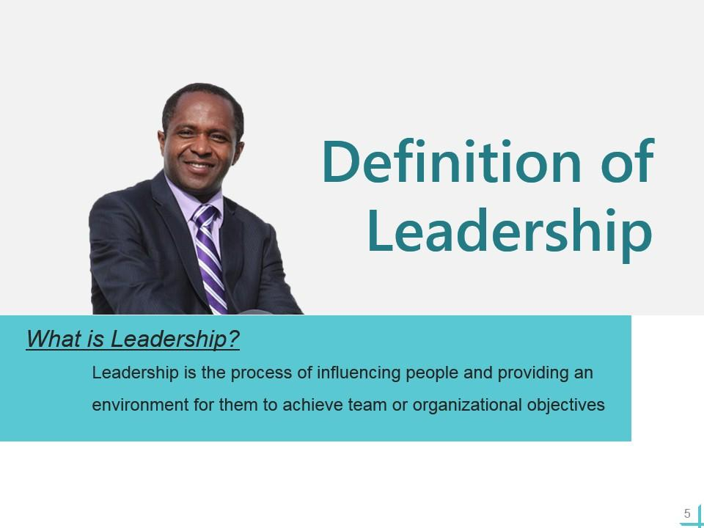

Slide 5
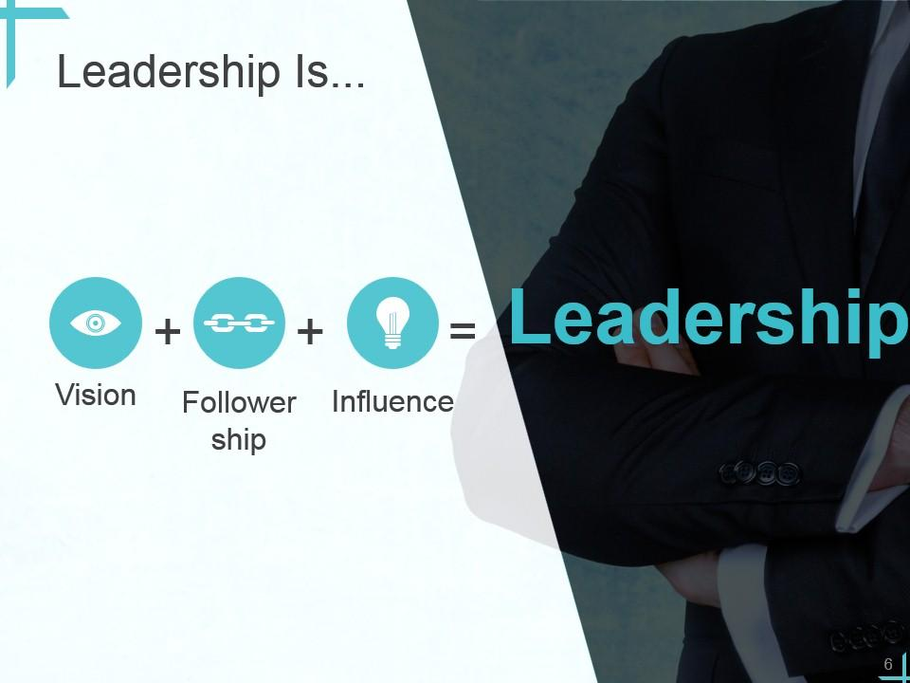

Slide 6
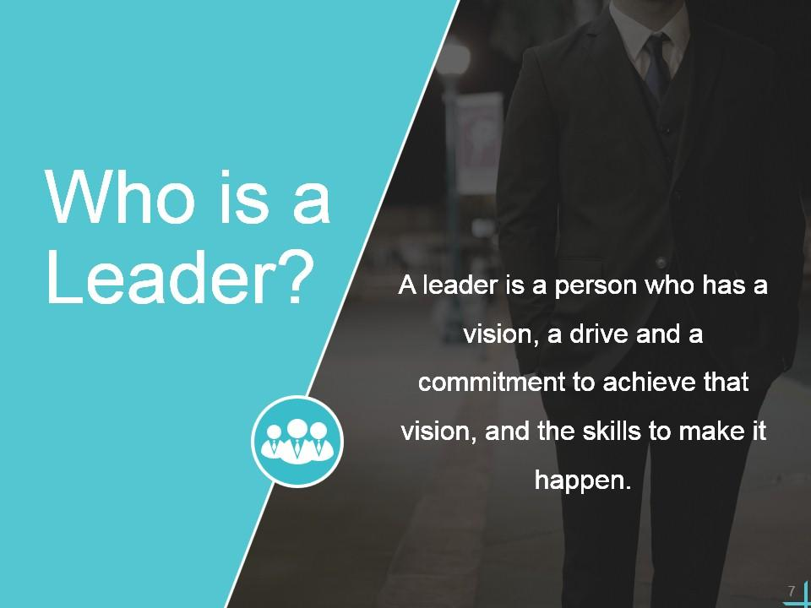

Slide 7
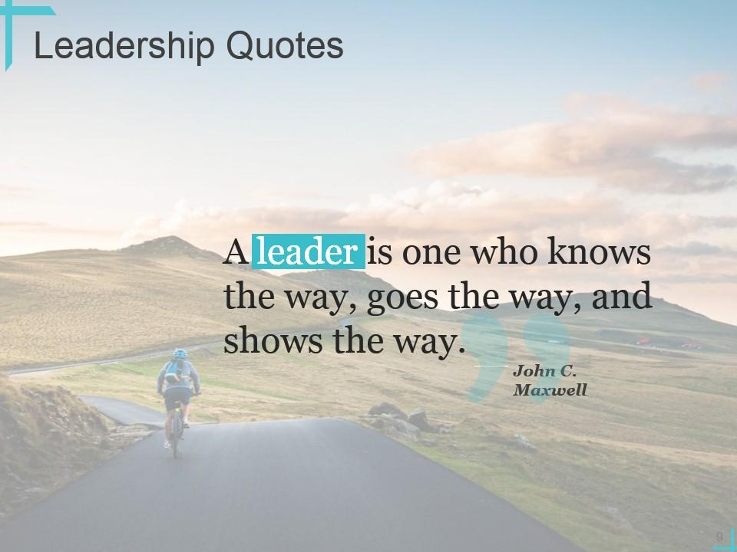

Slide 8
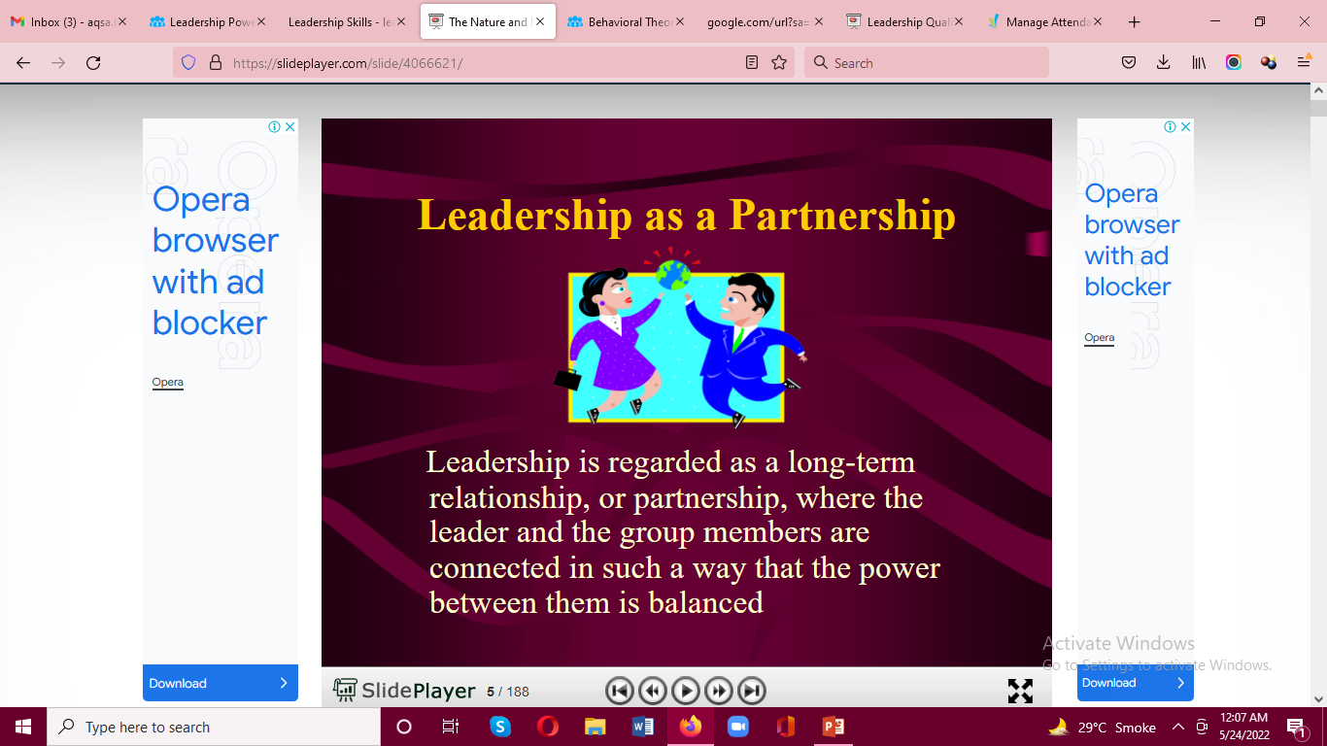

Slide 9
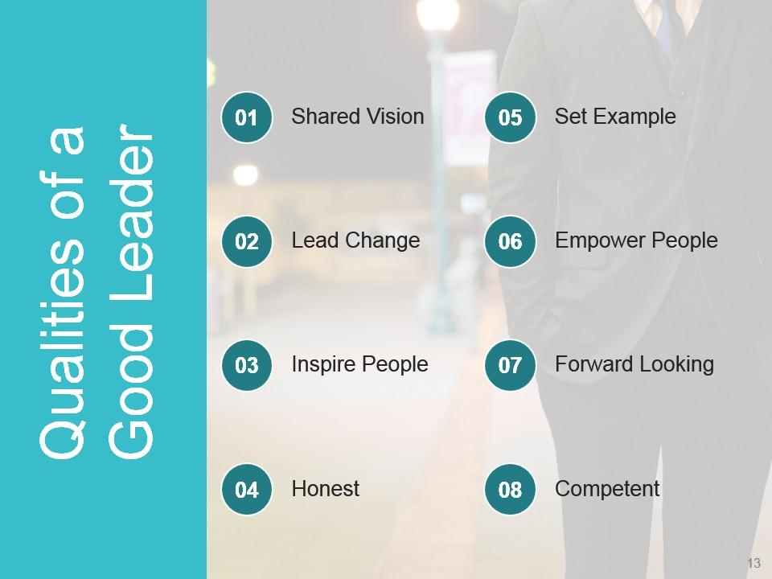

Slide 10
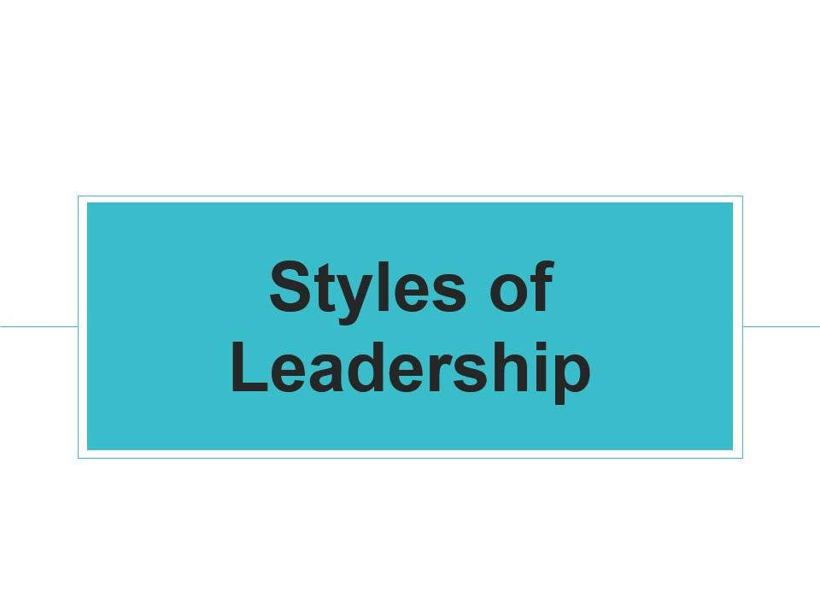

Slide 11
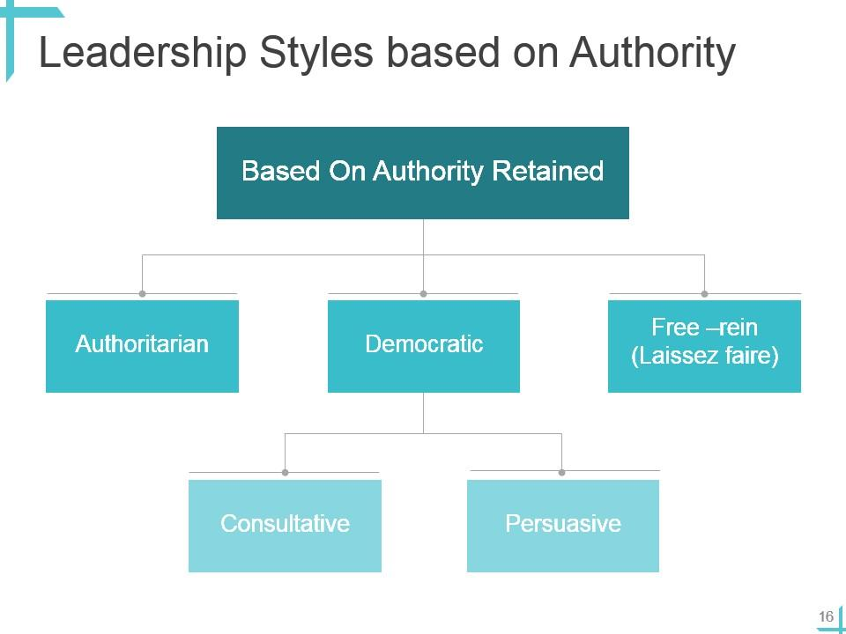

Slide 12
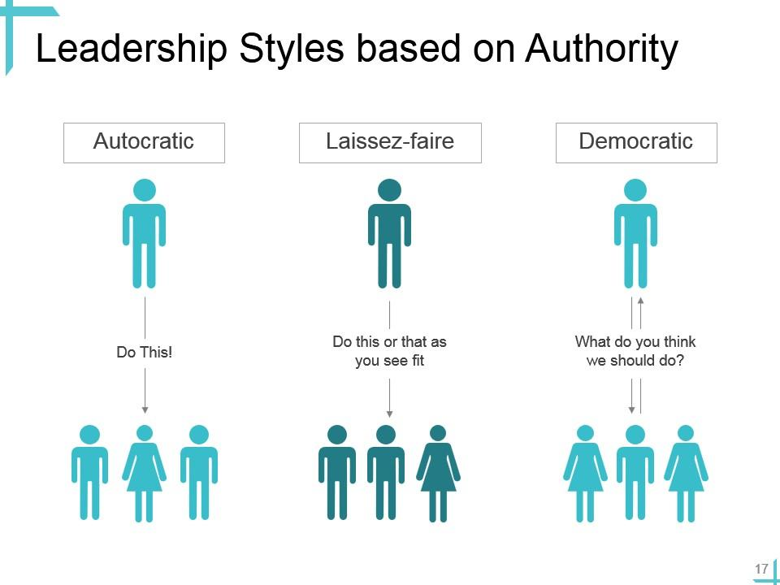

Slide 13
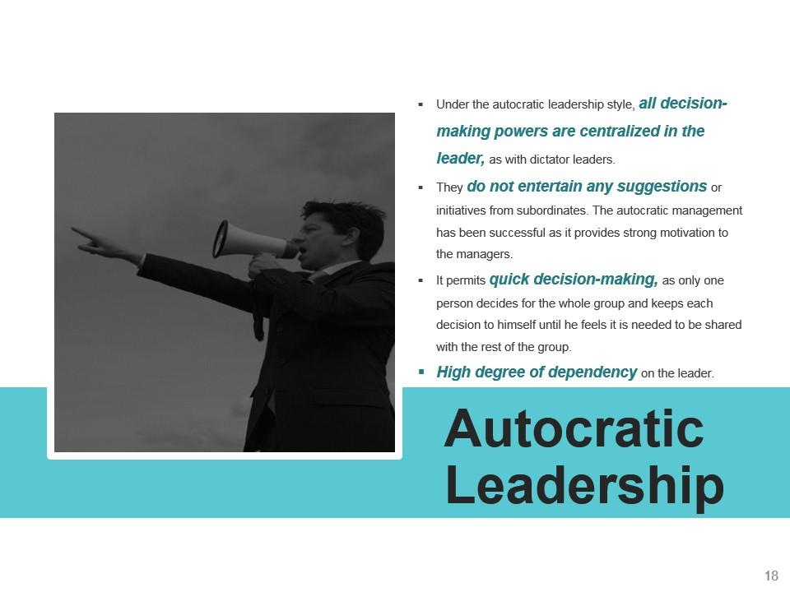

Slide 14

Autocratic:
Leader makes decisions without reference to anyone else
High degree of dependency on the leader
Can create de-motivation and alienation of staff
May be valuable in some types of business where decisions need to be made quickly and decisively

Slide 15
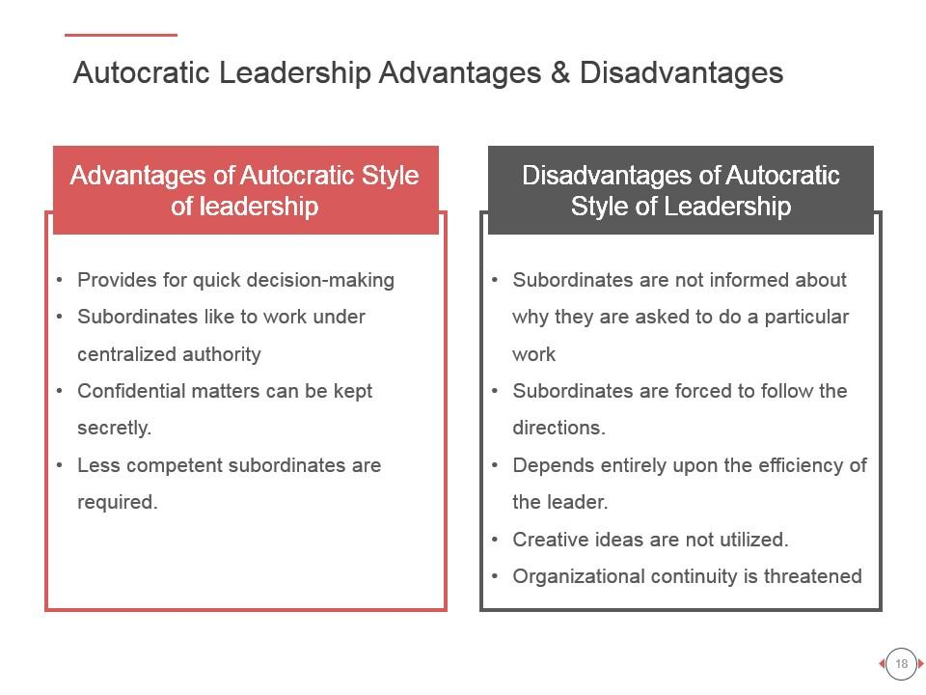

Slide 16
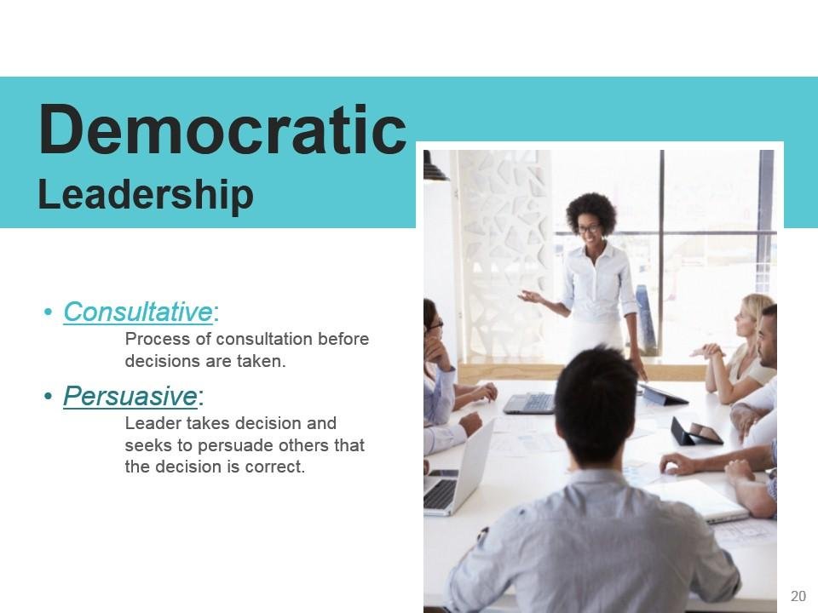

Slide 17
Democratic:
Encourages decision making from different perspectives – leadership may be emphasised throughout the organisation
Consultative: process of consultation before decisions are taken
Persuasive: Leader takes decision and seeks to persuade others that the decision is correct

Slide 18
May help motivation and involvement
Workers feel ownership of the firm and its ideas
Improves the sharing of ideas and experiences within the business
Can delay decision making

Slide 19
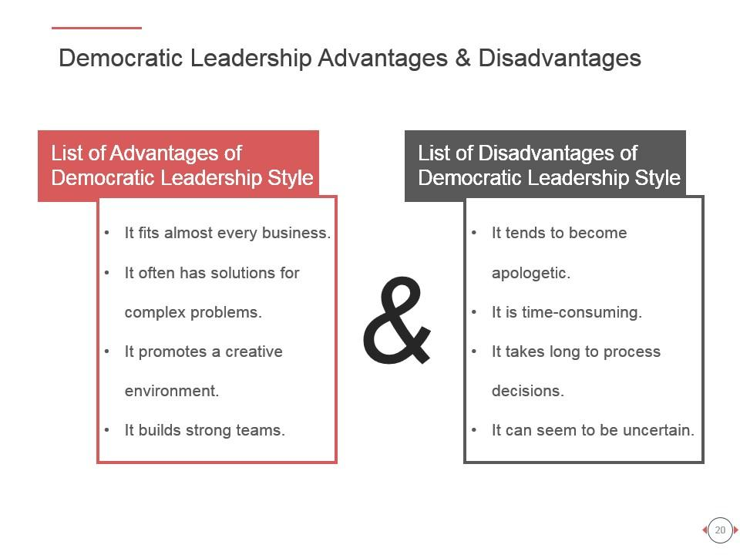

Slide 20
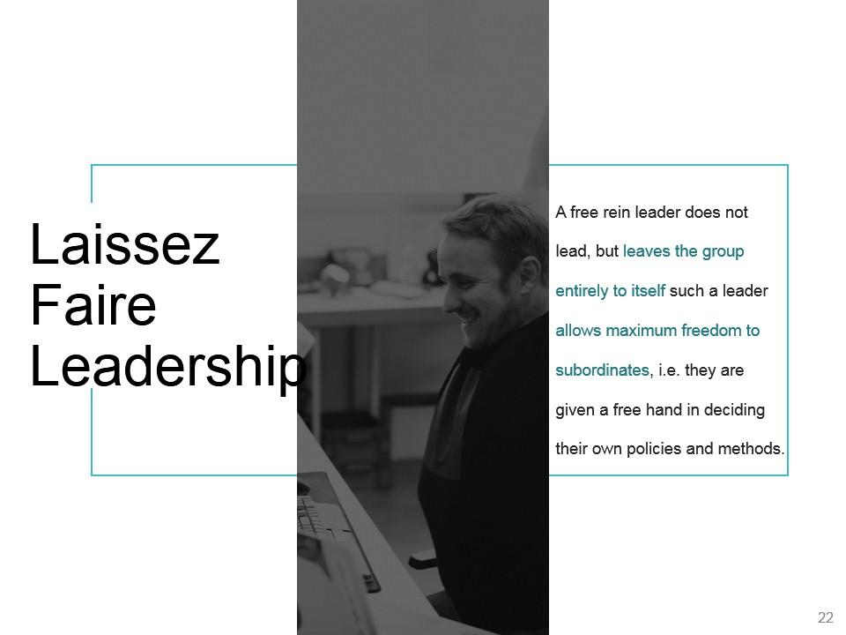

Slide 21
‘Let it be’ – the leadership responsibilities are shared by all
Can be very useful in businesses where creative ideas are important
Can be highly motivational, as people have control over their working life
Can make coordination and decision making time-consuming and lacking in overall direction
Relies on good team work
Relies on good interpersonal relations

Slide 22
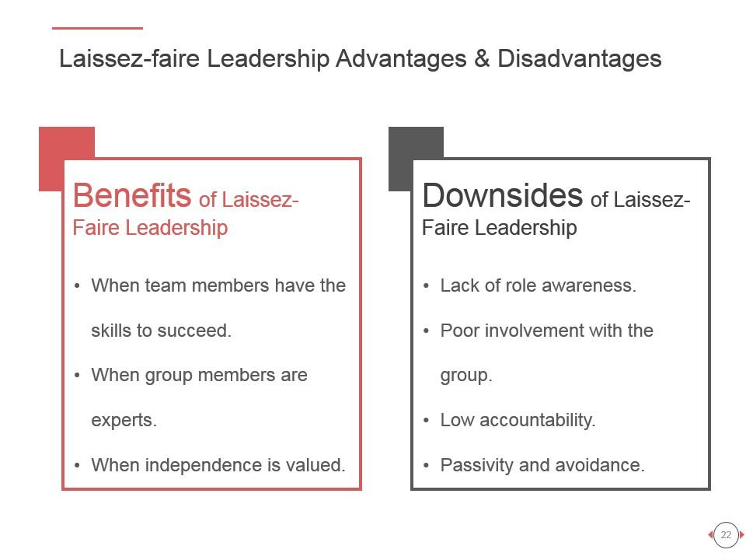

Slide 23
Recipe for being a Leader
Take control of your life
Assume responsibility for who you are
Convey a positive and dynamic attitude in everything you do
Accept blame: learn from your own mistakes as well as those of others. Take blame for everything that happens in your unit
Give credit wherever it is due
Be compassionate when you review your team members' progress or lack thereof

Slide 24
CONT….
Think great thoughts. Small thinking is why companies go broke
Turn disasters into opportunities. Turn every obstacle into a personal triumph
Determine your "real" goals then strive to achieve them
When you want to tell someone something important, do it personally
Listen effectively
Encourage teamwork and participation
Empower team members

Slide 25
CONTI…
Communicate effectively
Emphasize long-term productivity
Make sound and timely decisions
Treat each person as an individual
Know yourself and your team
Protect your team
Have vision, courage and commitment

Slide 26


